Slide 1
Introduction to Biochemistry
Chapters 20
Outline
Carbohydrates
Lipids
Proteins
Enzymes
Nucleic Acids

Slide 2
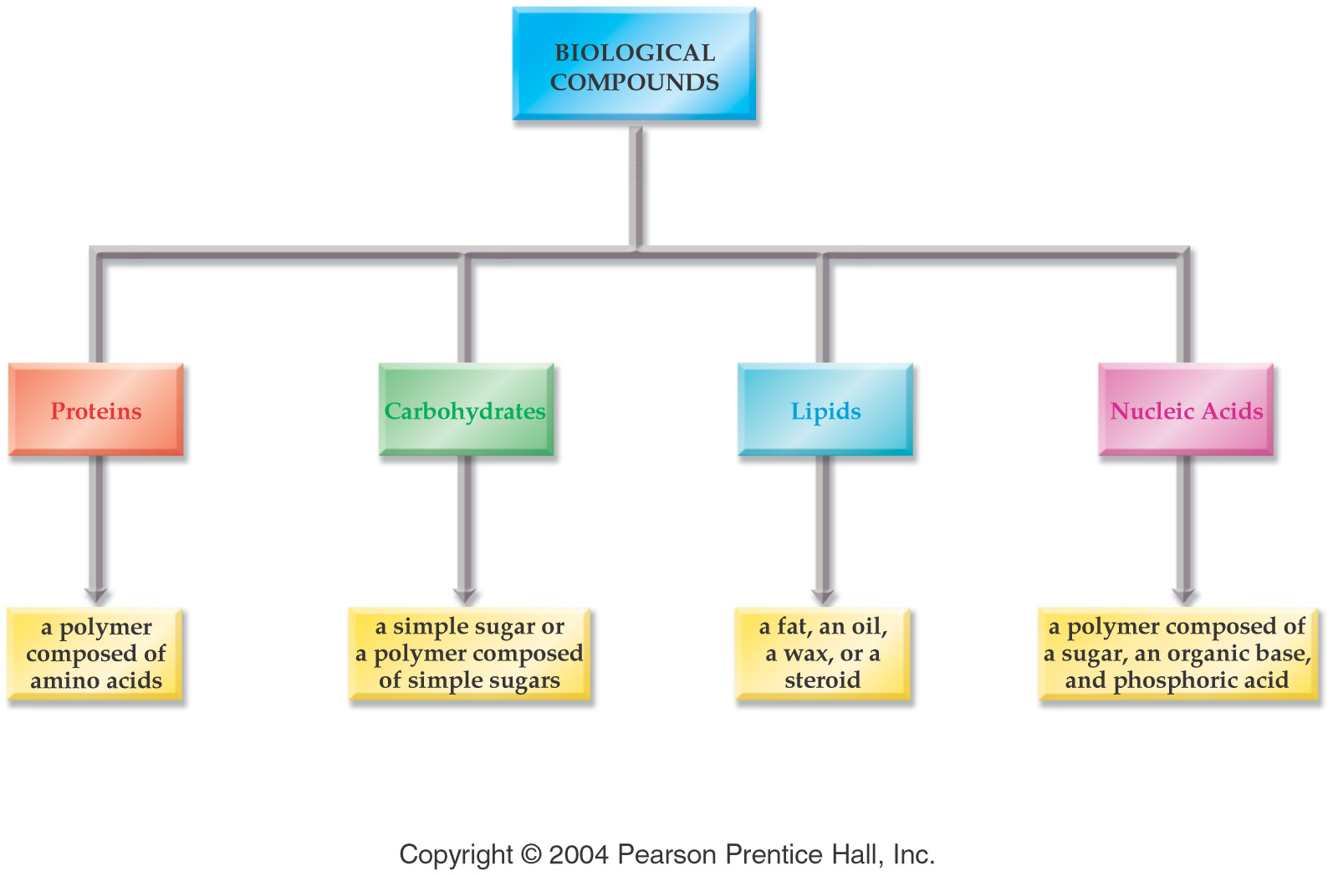

Slide 3
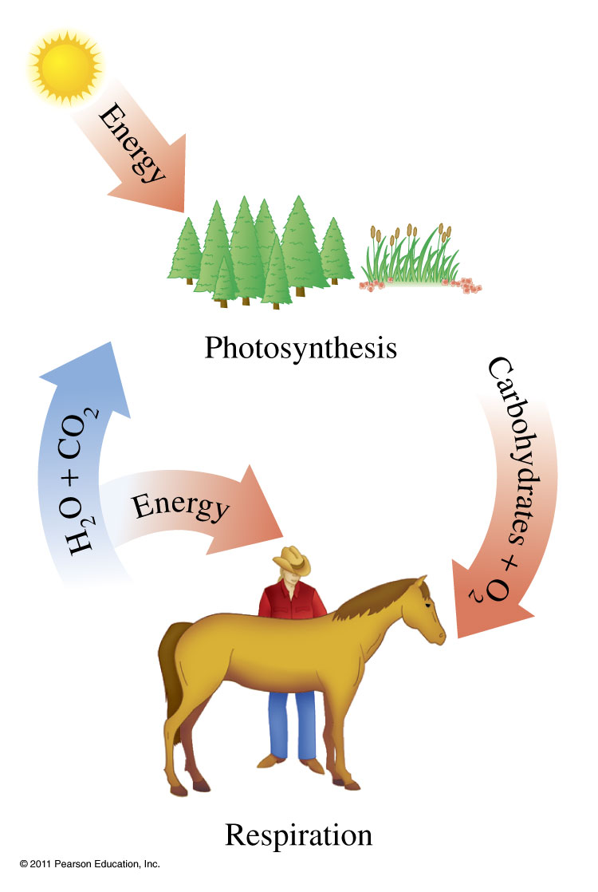
How are carbohydrates formed?

Slide 4
What do monosaccharaides look like?
D-(-)-glucose
D-(+)-galactose
D-(+)-mannose
D-(-)-fructose

Slide 5
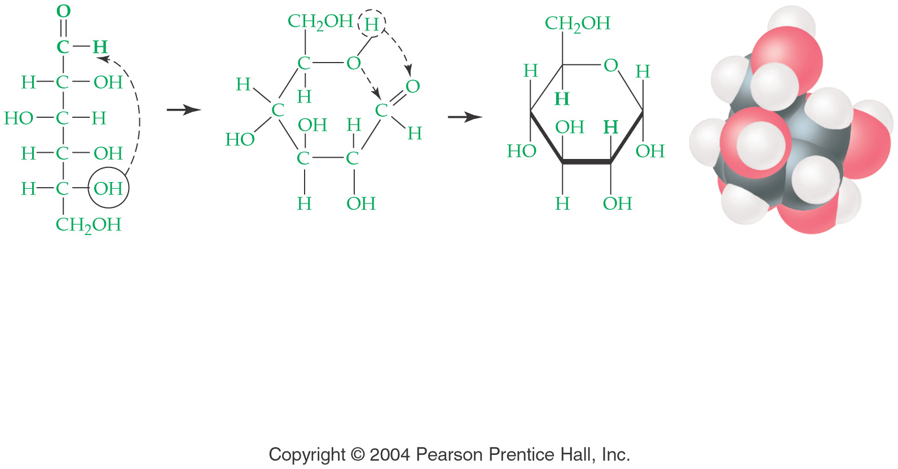
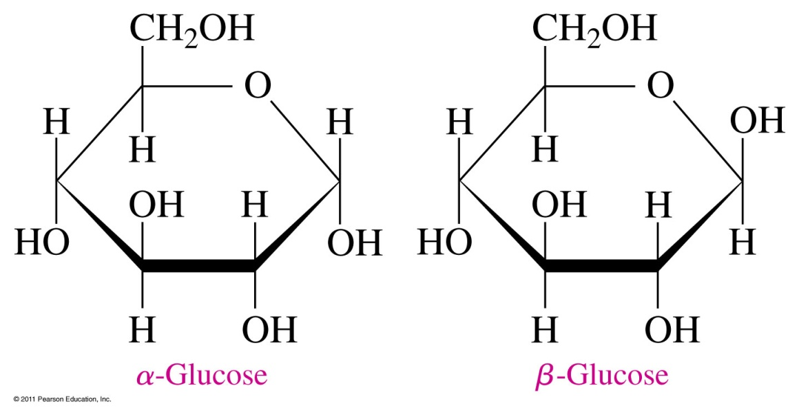
What do sugars do in a solution?

Slide 6
What does a disaccharide look like?
glucose glucose
Maltose
Sucrose
Lactose

Slide 7
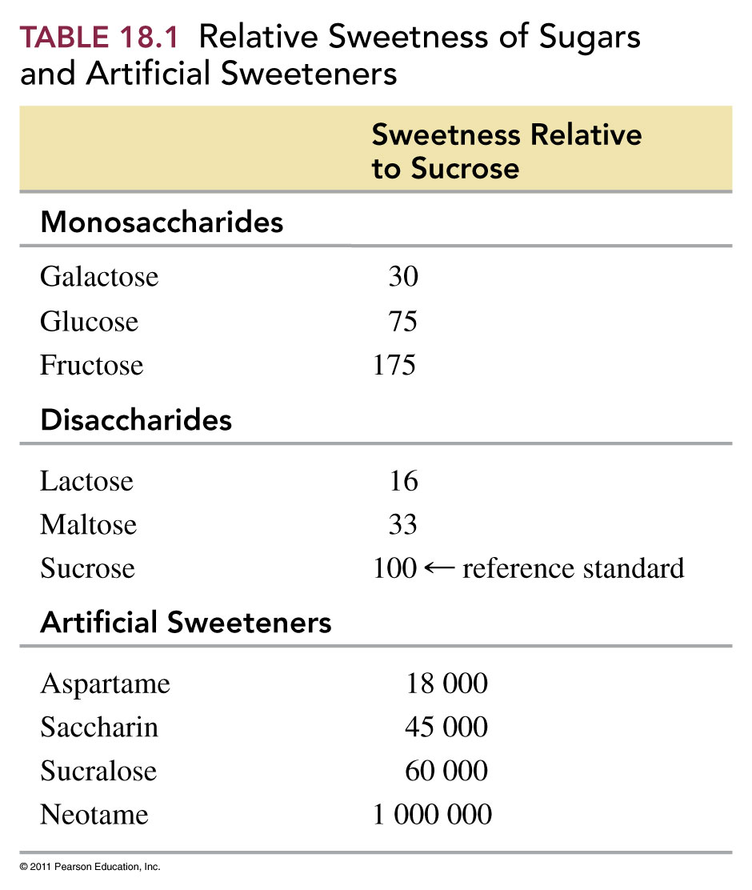

Slide 8
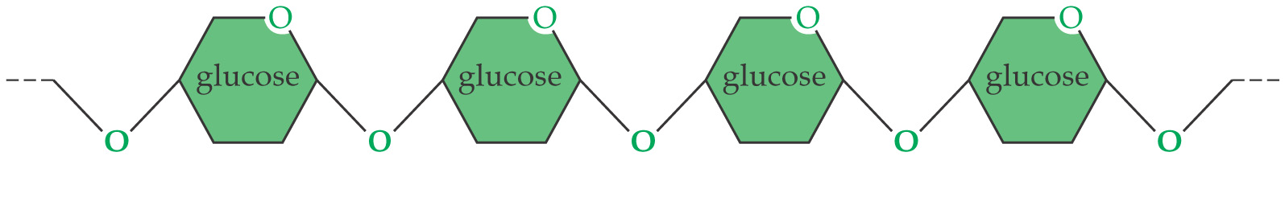
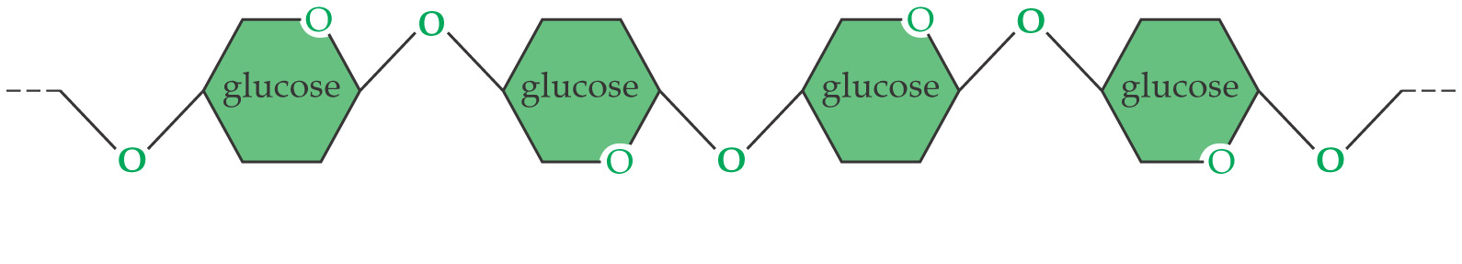
How does the structure of polysaccharides differ from monosaccharide and disaccharides?
starch
cellulose

Slide 9
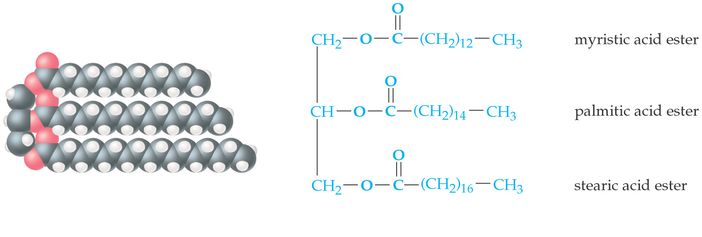
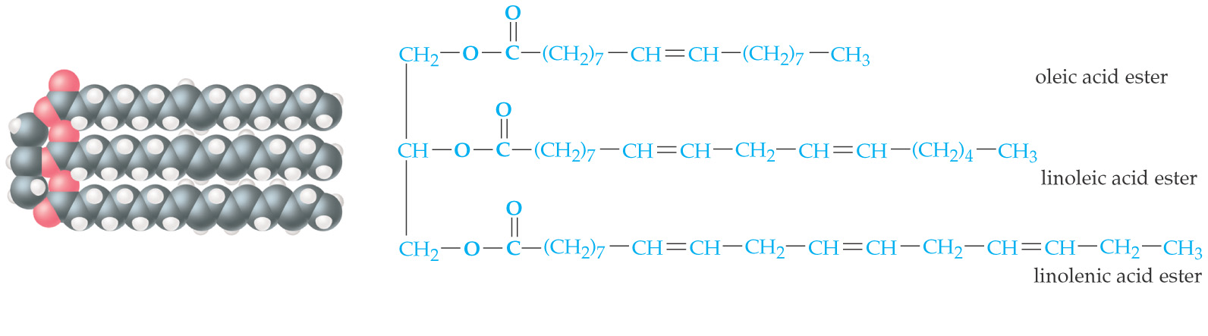
How are saturated and unsaturated fats different?
Saturated fat
Unsaturated fat

Slide 10
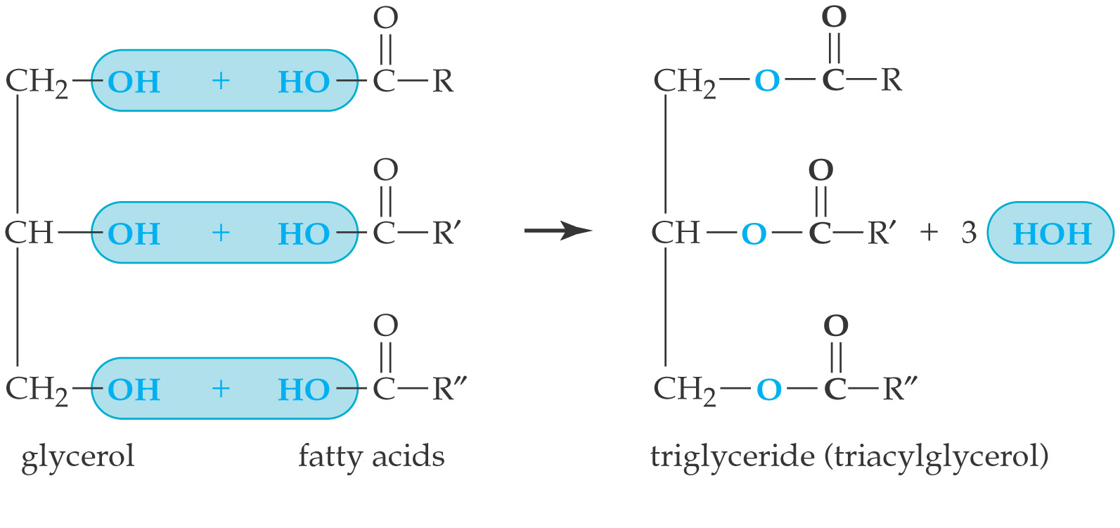
How are triglycerides formed?

Slide 11
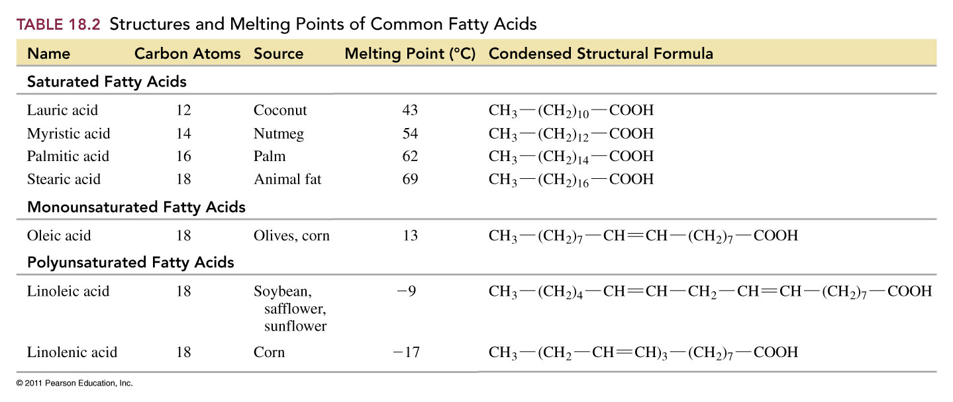

Slide 12
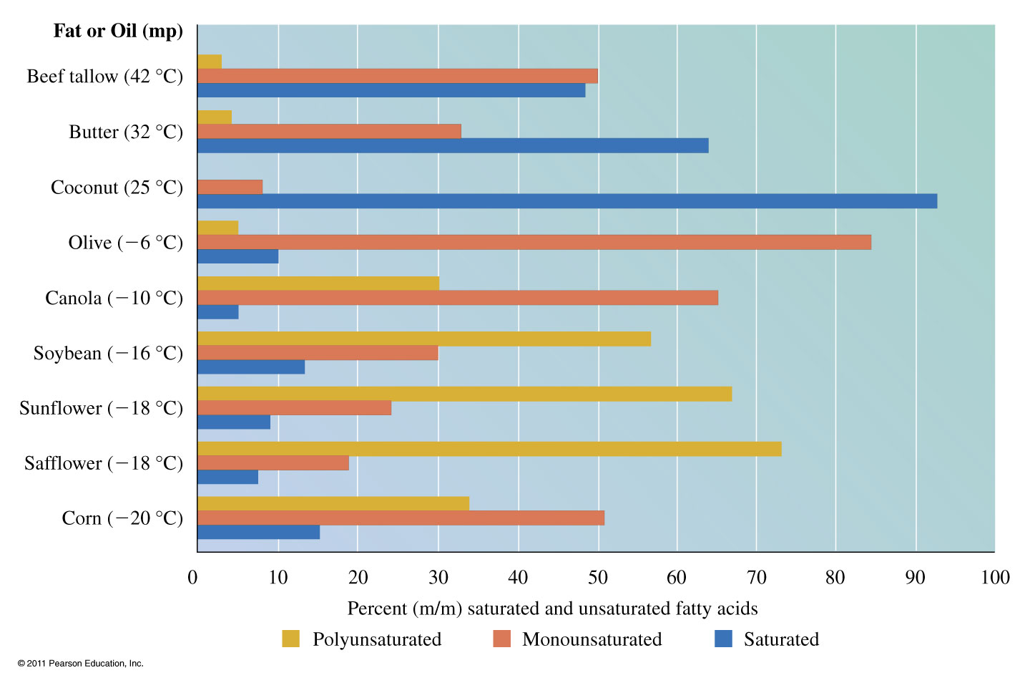
What type of fatty acids make up the following fats and oils?

Slide 13
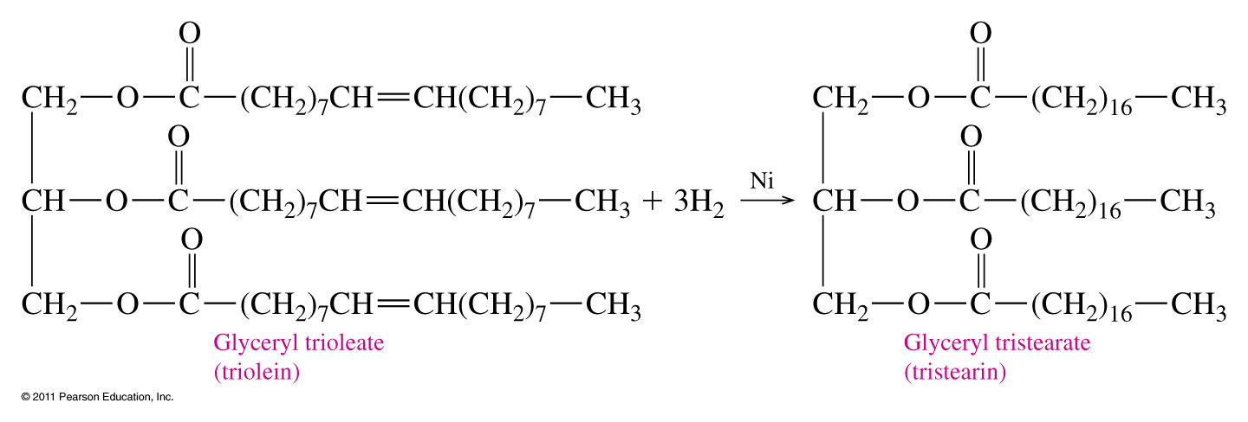
How are unsaturated triacylglycerols converted to saturated triacylglycerols?
Hydrogenation Reaction:

Slide 14
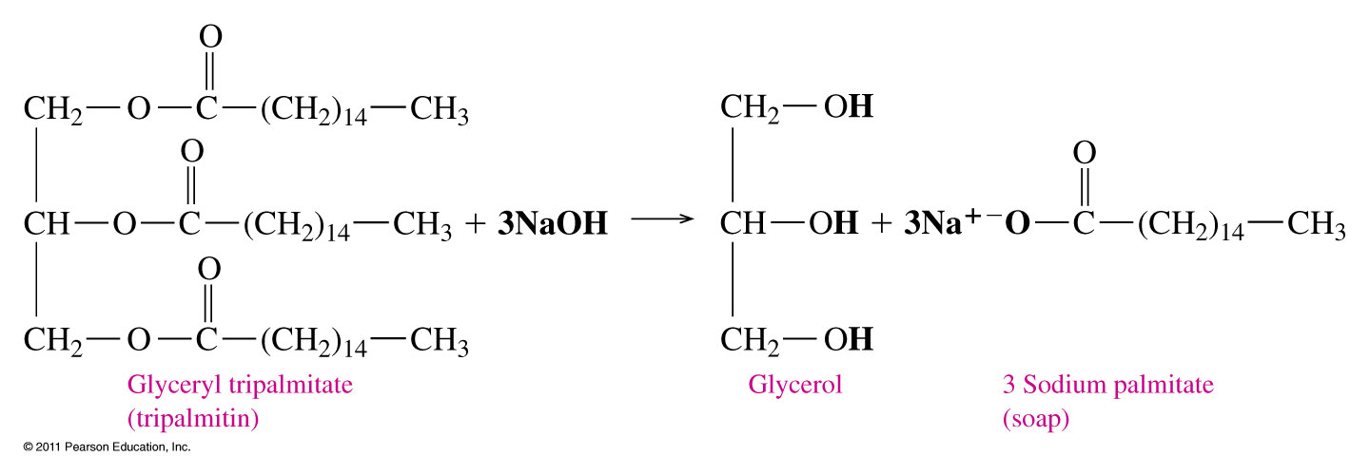
How is soap formed?

Slide 15
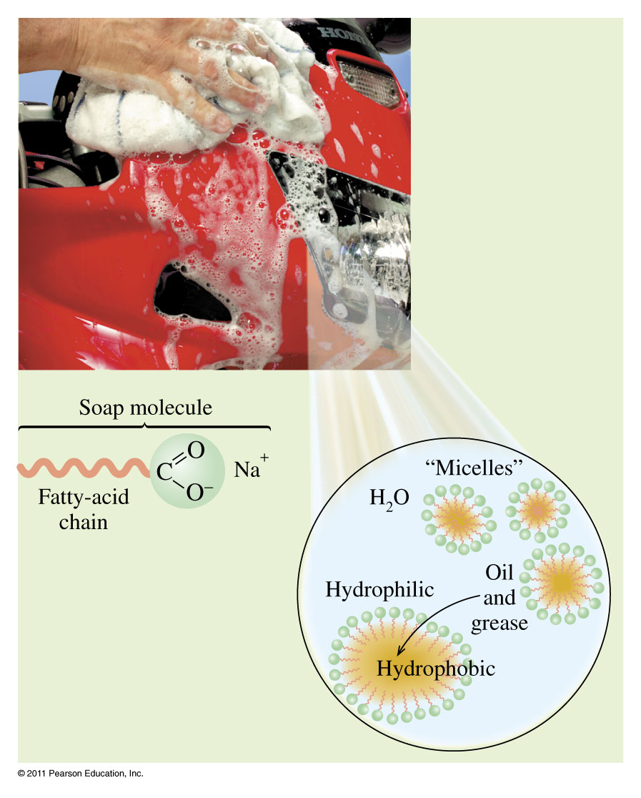
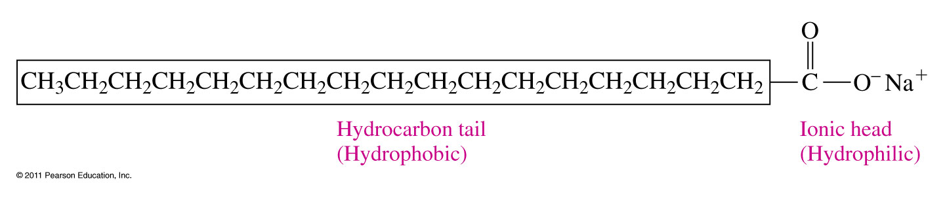
How do soaps work??

Slide 16
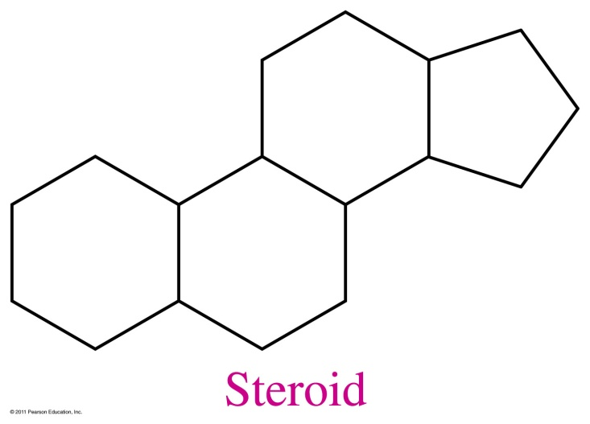
What do steroids look like?

Slide 17
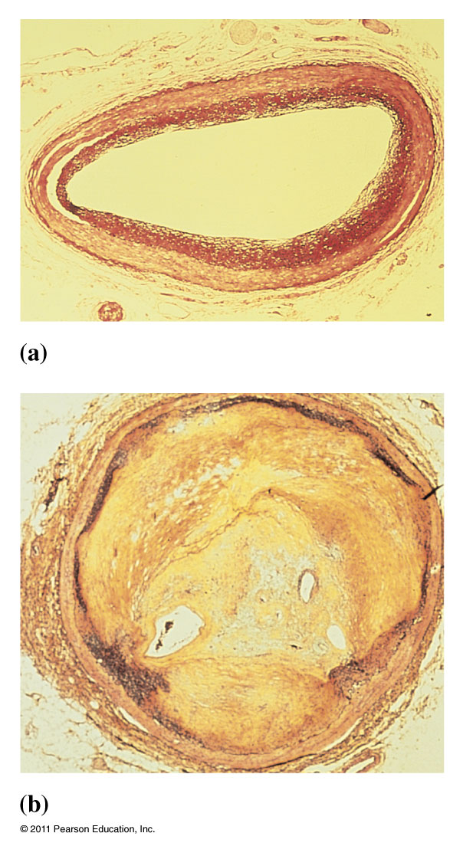
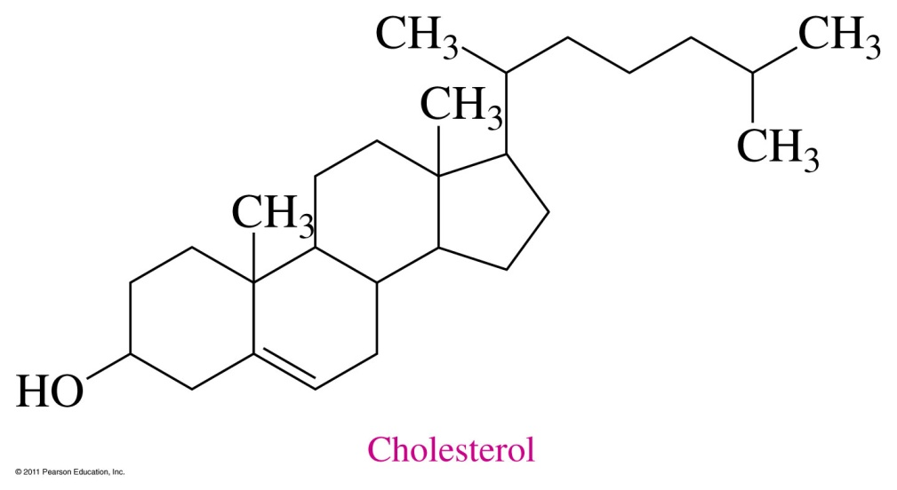
What does cholesterol look like?

Slide 18
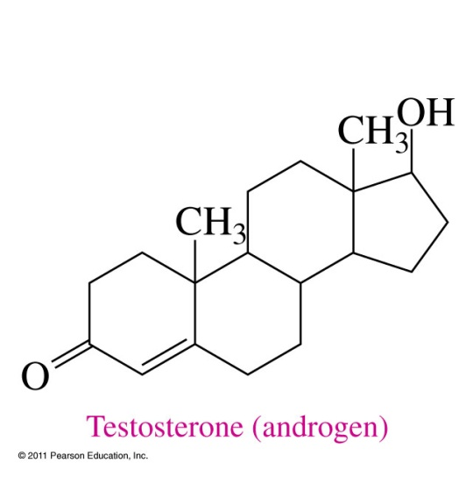

What do steroid hormones look like?

Slide 19
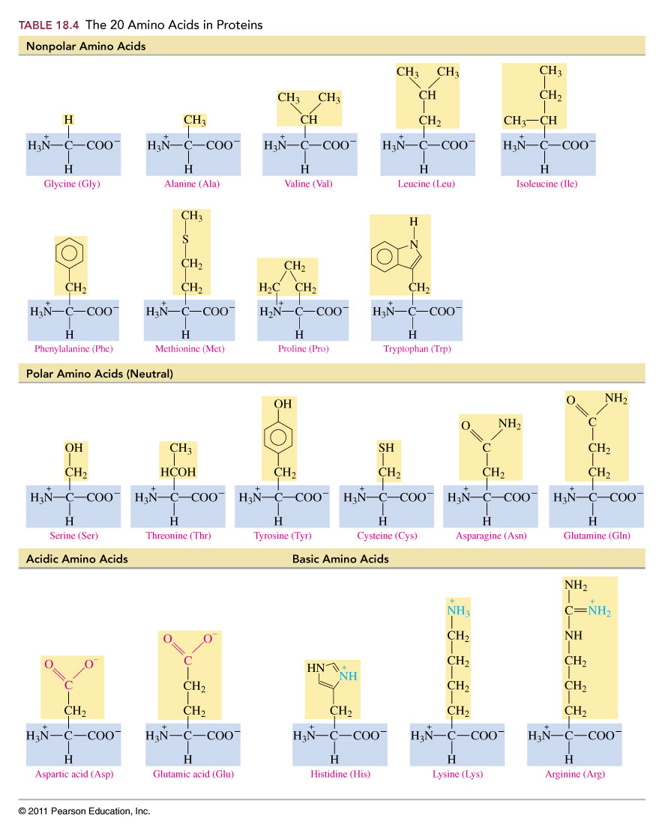
What makes an amino acid nonpolar?

Slide 20
What makes an amino acid polar?

Slide 21
What makes amino acids acidic or basic?

Slide 22
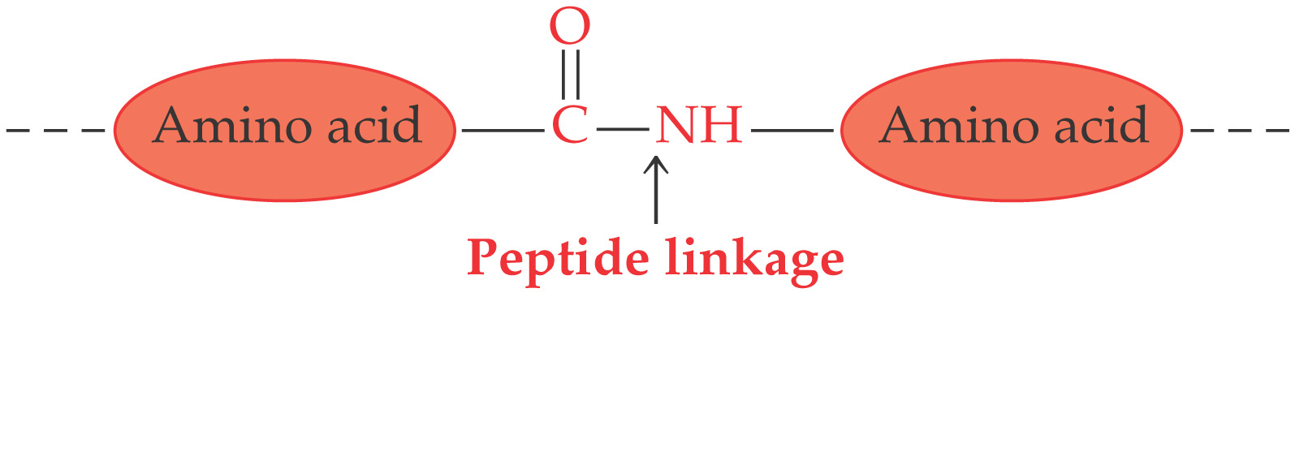
What are proteins?

Slide 23
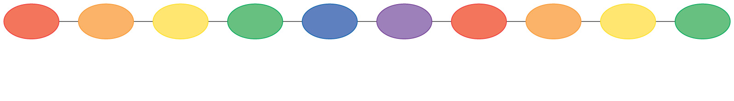
What is the primary structure of a protein?

Slide 24
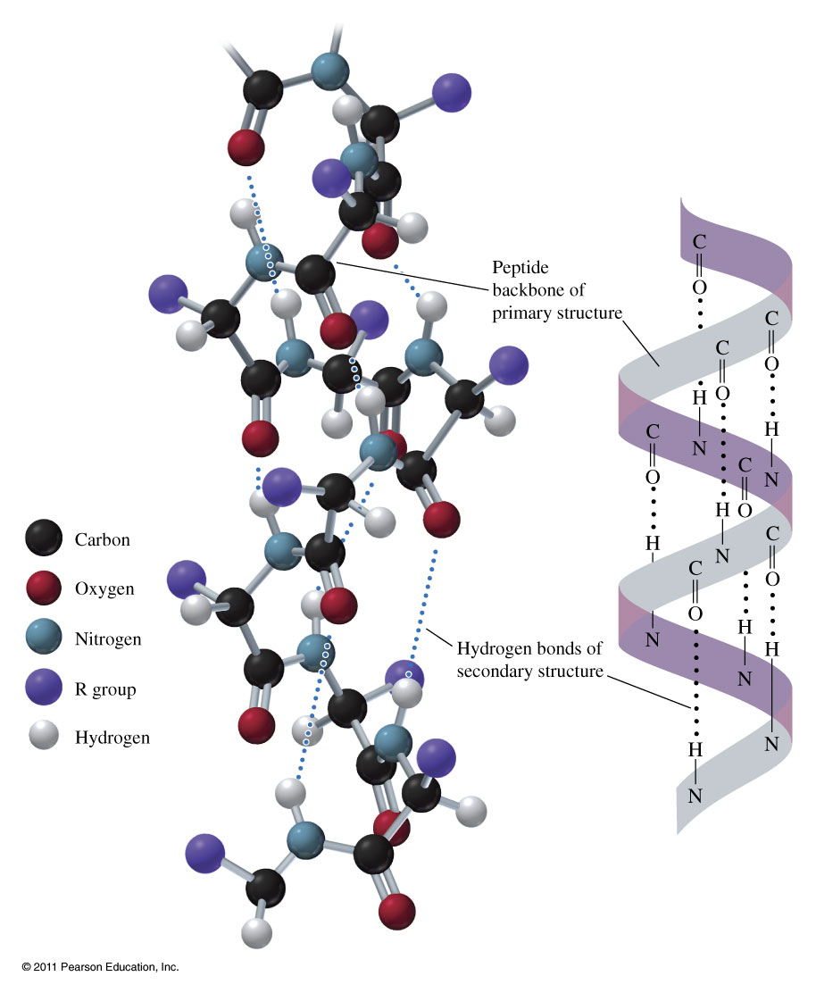
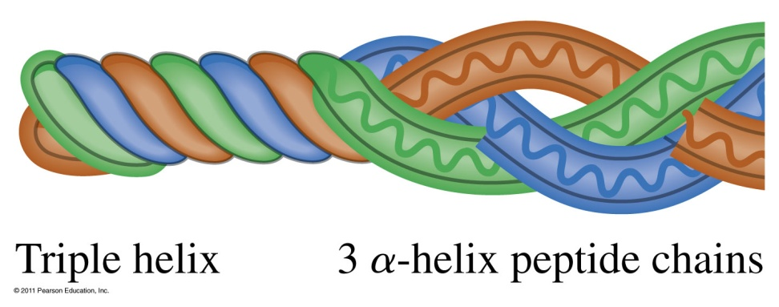
What does the secondary structure look like?
Alpha Helix

Slide 25
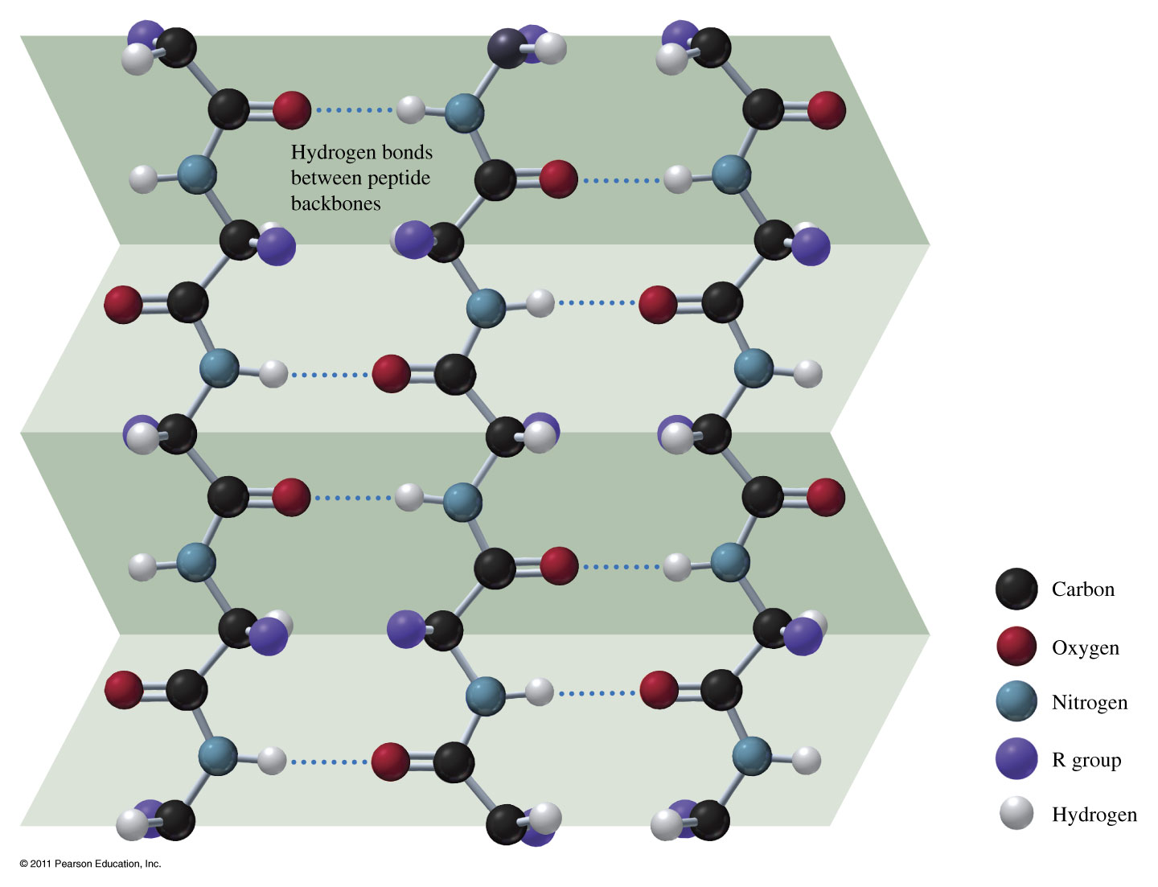
What does the secondary structure look like?
Beta Sheet

Slide 26
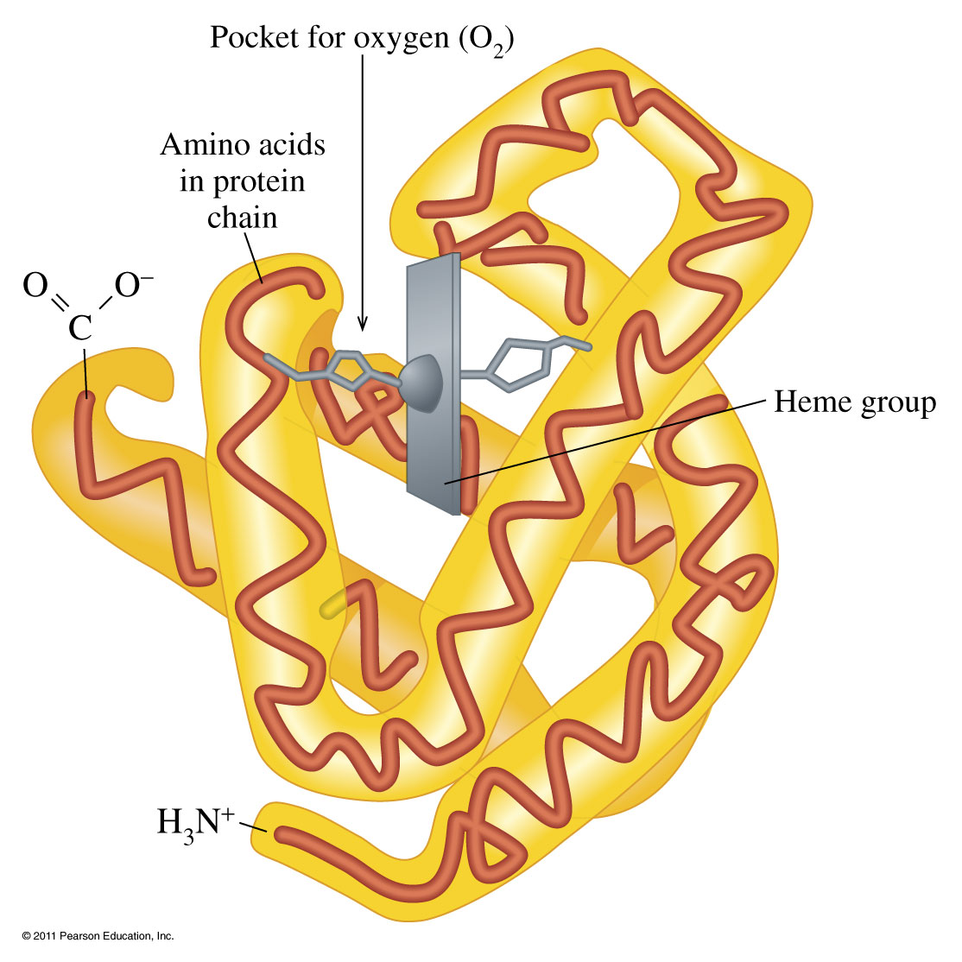
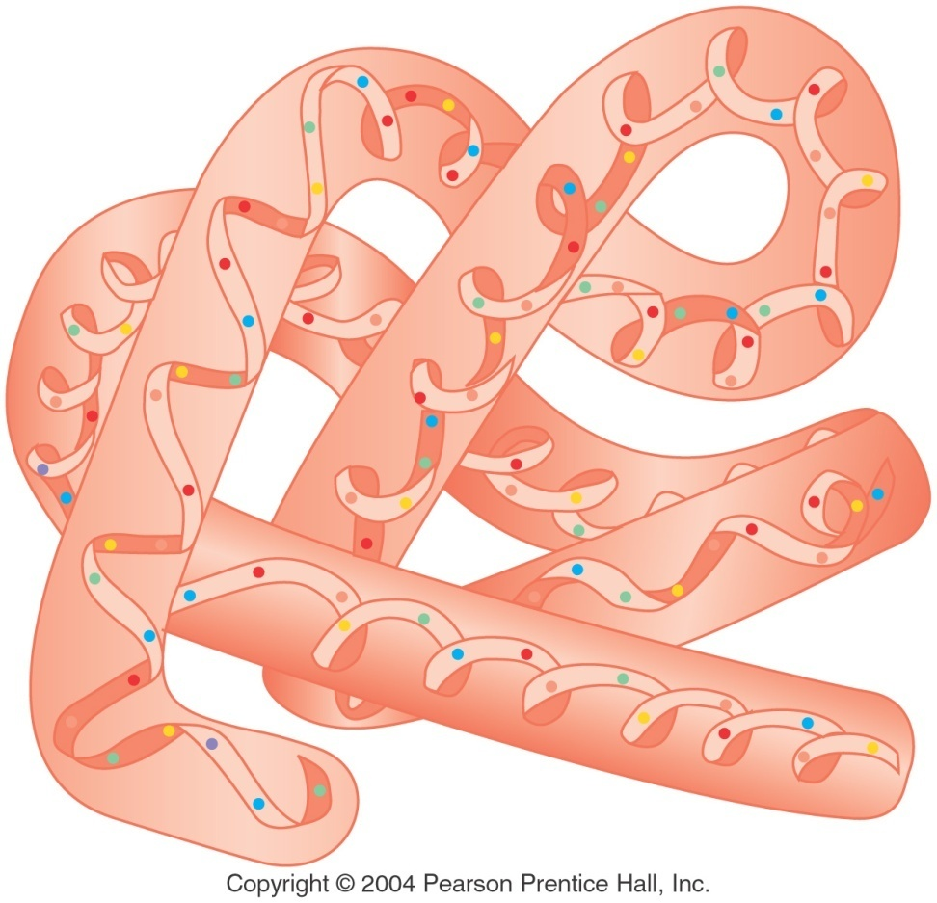
What is the tertiary structure of a protein?

Slide 27
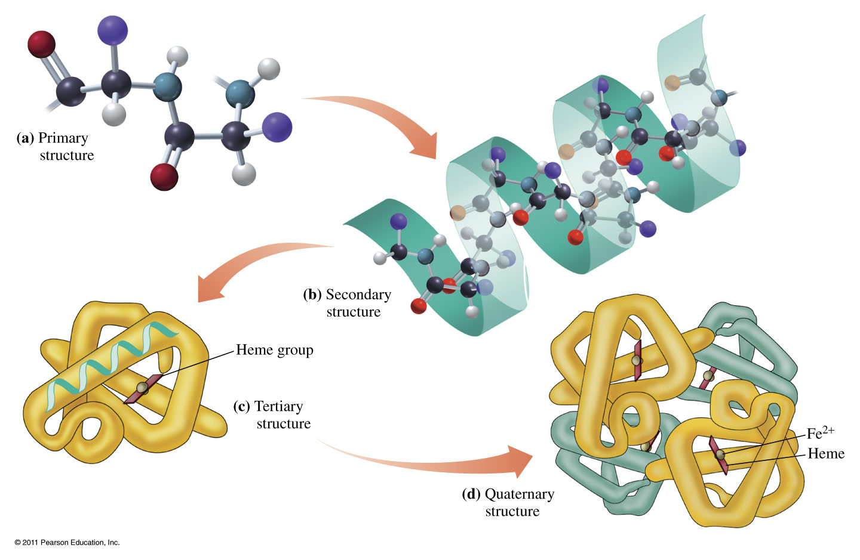
How are the different protein structures related?

Slide 28
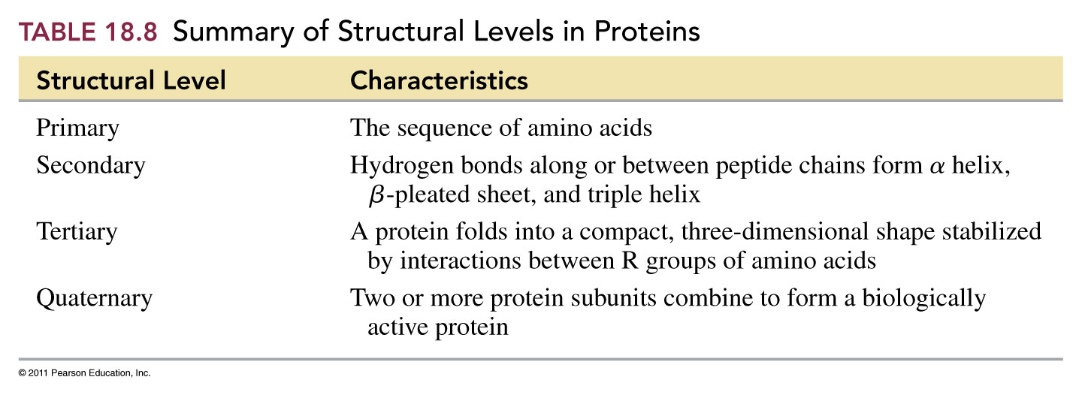

Slide 29
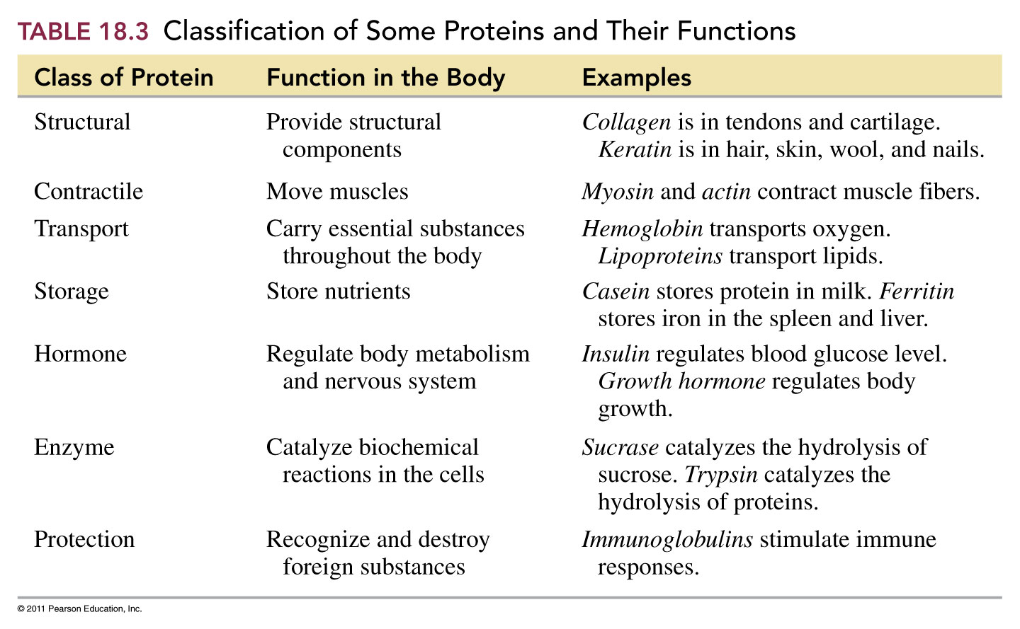

Slide 30
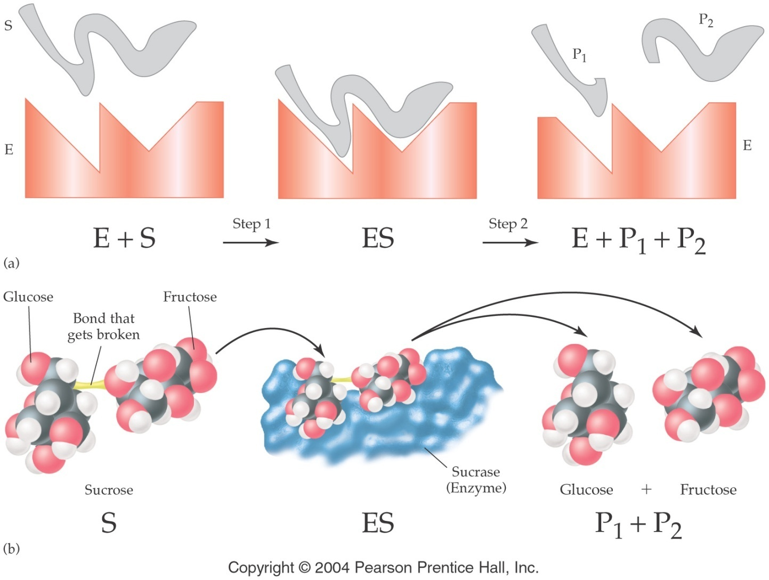
What does an enzyme do?

Slide 31
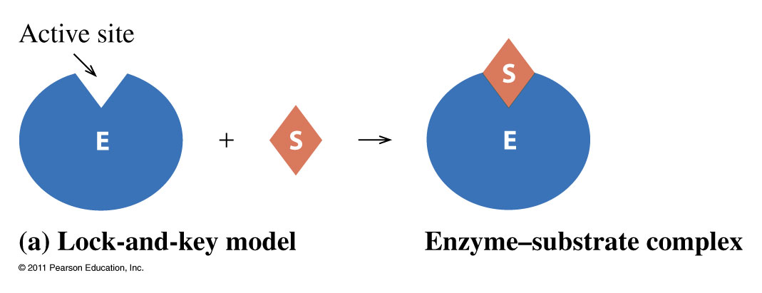
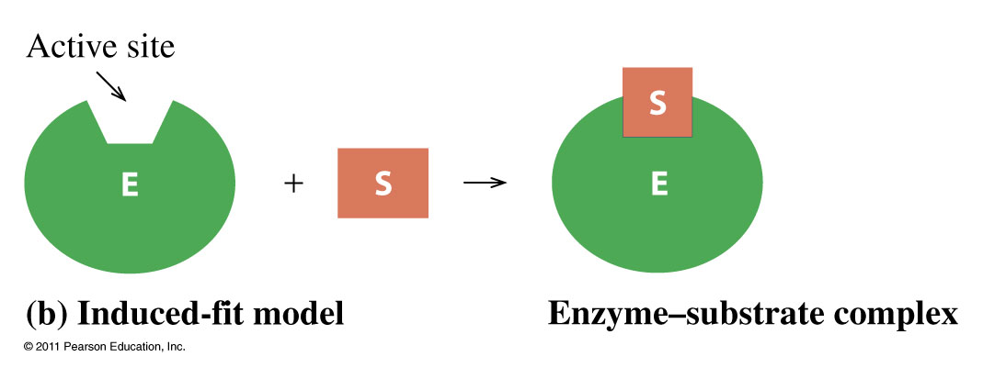
How do enzymes work?

Slide 32
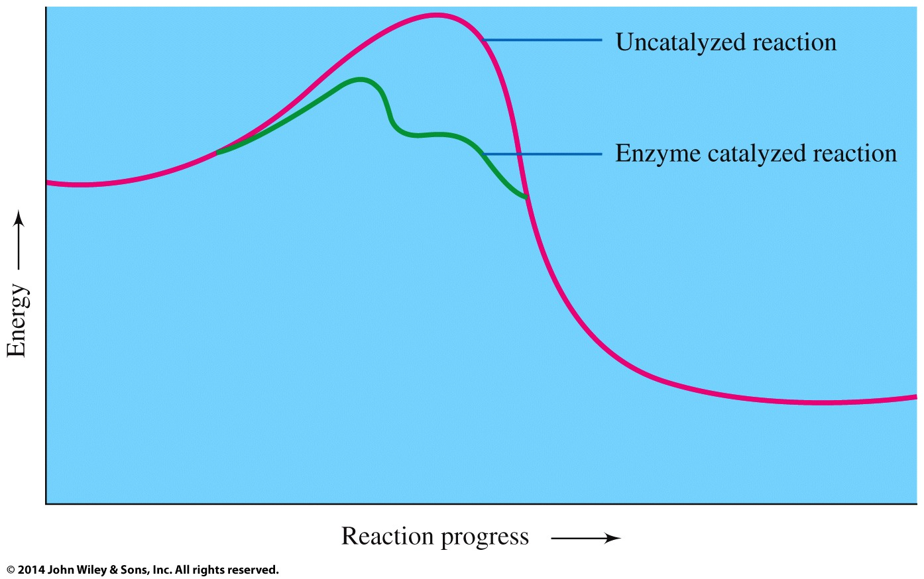

Slide 33
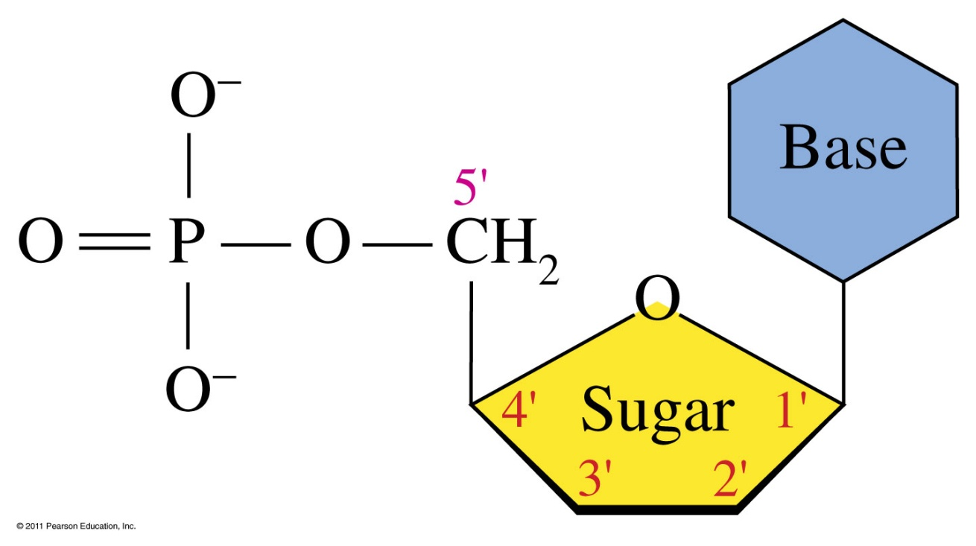
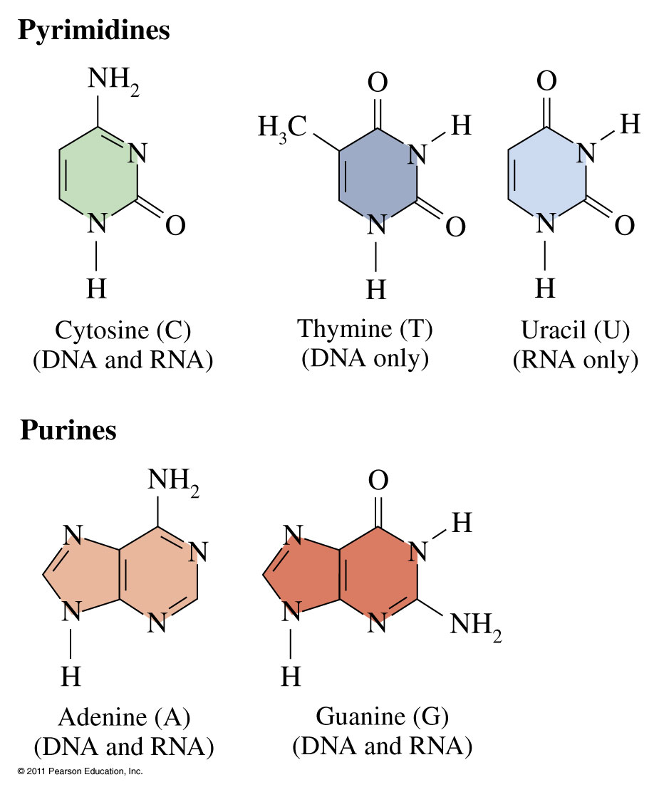
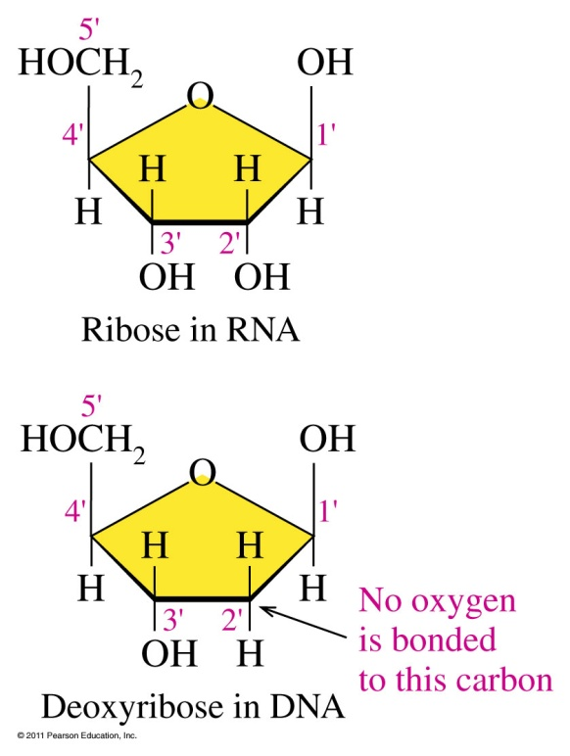
What is a nucleic acid?
What do the bases look like?

Slide 34


Slide 35
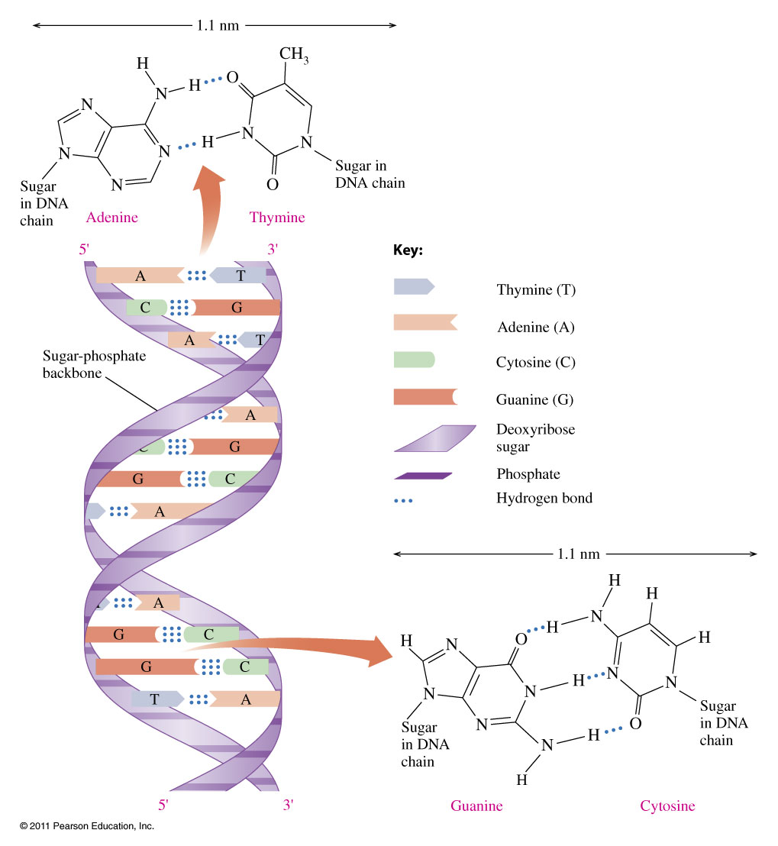
What is the structure of the double helix?

Slide 36
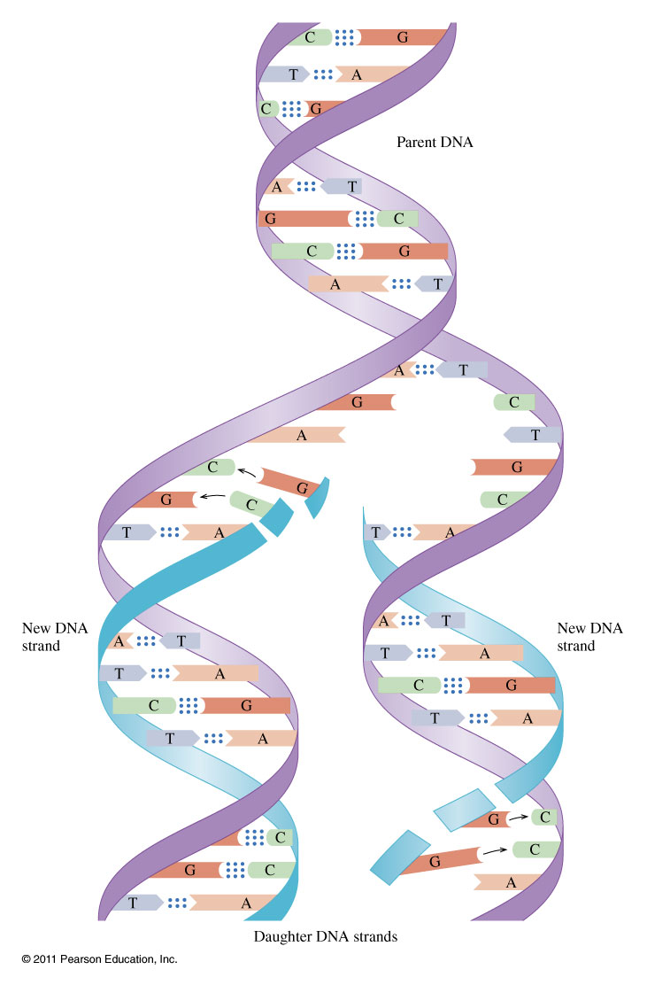
How does DNA replication work?

Slide 37
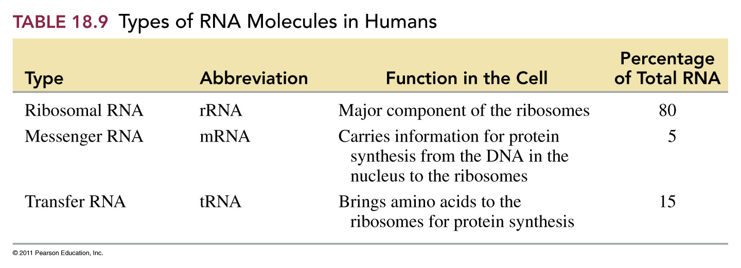

Slide 38
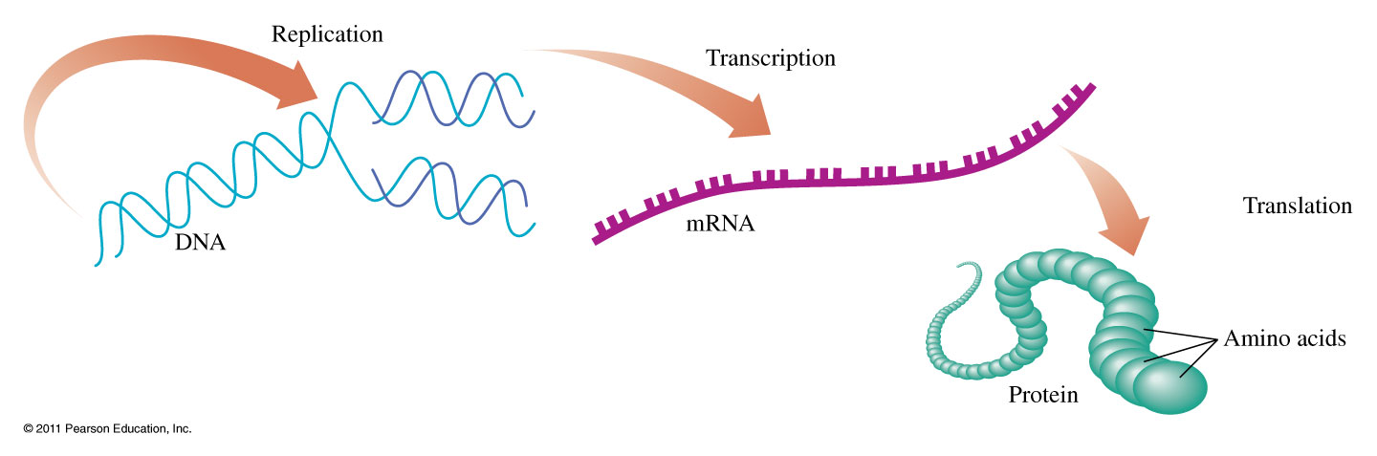
How does protein synthesis work?

Slide 39
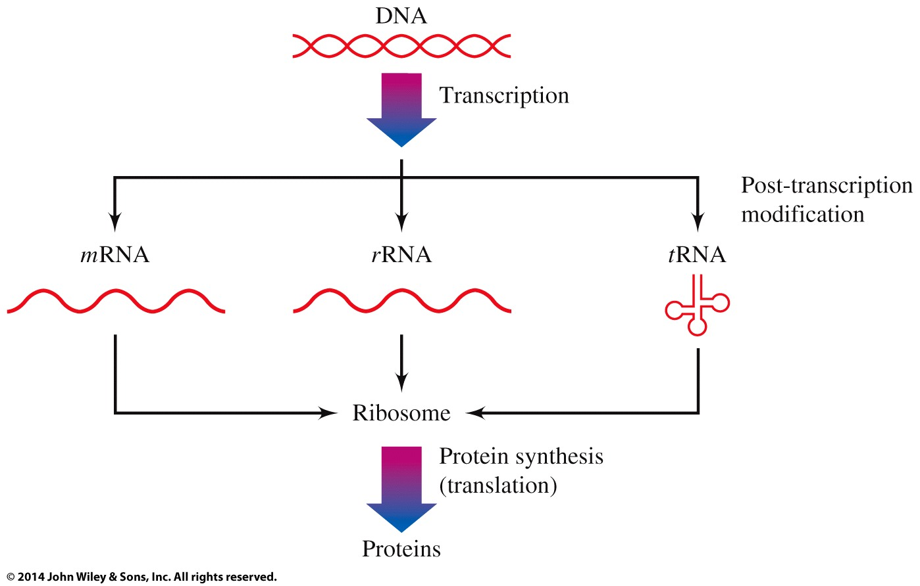
How does protein synthesis work?

Slide 40
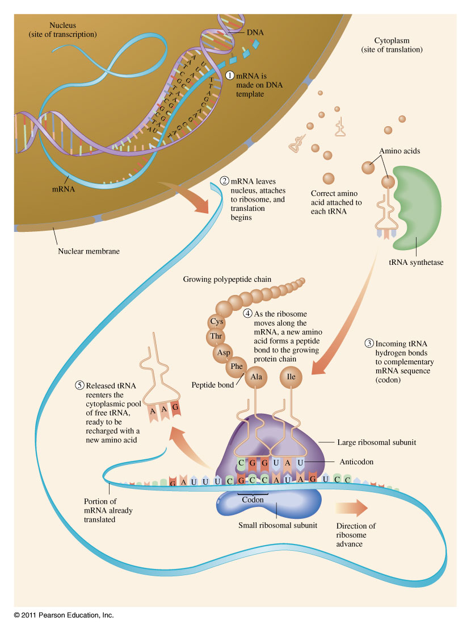
How does transcription in protein synthesis work?

Slide 41
